Slide 1


ERP SYSTEM FOR COLLEGE MANAGEMENT – GROUP 1

Slide 2
Team Members
Sr no. | Employee ID | Name
1 | 2587619 | Abhishek Dhal
2 | 2587525 | Abhishek Yadav (Team Lead)
3 | 2587401 | Bethala Sai Krishna
4 | 2586874 | Akumalla Anjani Shehanaj
5 | 2586967 | Ameersohil S Madalmatti
6 | 2587221 | Anuj Kumar Gupta
7 | 2587393 | Archana P
8 | 2587808 | B Dheeraj

Slide 3
Table of Contents
Introduction
Proposed System
Advantages of Proposed System
Tools and Technologies
Admin Module
Faculty Module
Student Module
Librarian Module
ER diagram
Output
Unit Testing
Functional Testing
Advantages
Future Scope
Conclusion

Slide 4
Introduction
Title: ERP System for College Management
Objective: Introducing a comprehensive ERP system designed specifically for managing various aspects of educational institutions, including schools and colleges.
Agenda:
Overview of the proposed system
Key functionalities and modules
Advantages of the proposed system
Technologies used
Demonstration of system output
Testing procedures and results
Future scope and conclusion

Slide 5
Proposed System
In response to the growing need for streamlined management within educational institutions, we present an ERP (Enterprise Resource Planning) System tailored specifically for College Management. This comprehensive solution addresses the complexities faced by schools, colleges, and universities in managing various administrative tasks effectively and efficiently.
Key Features:
Management of Faculties: Centralized database for employee records, including personal details, roles, and responsibilities.
Management of Students: Track student information, academic performance, attendance, and disciplinary records.
Management of Books and Library Records: Inventory management, circulation tracking, and fine calculation for library resources.

Slide 6
Admission Process: Streamline the admission process from application submission to enrollment, including documentation and fee management.
Events and Timetable Management: Schedule and manage academic and extracurricular events, as well as student timetables.
The proposed ERP system aims to provide a centralized platform for all stakeholders, including administrators, faculty, students, and librarians, fostering efficient communication, collaboration, and data-driven decision-making. With its user-friendly interface and robust functionality, the system promises to revolutionize college management and enhance overall organizational effectiveness.

Slide 7
Advantages of Proposed System
ØEfficiency
ØData Accessibility
ØCost Savings
ØEnhanced security
ØReduced workload

Slide 8




Tools and Technologies
Frontend – Angular
Backend - Spring Boot, Hibernate
Database - MySQL
Server – Tomcat

Slide 9
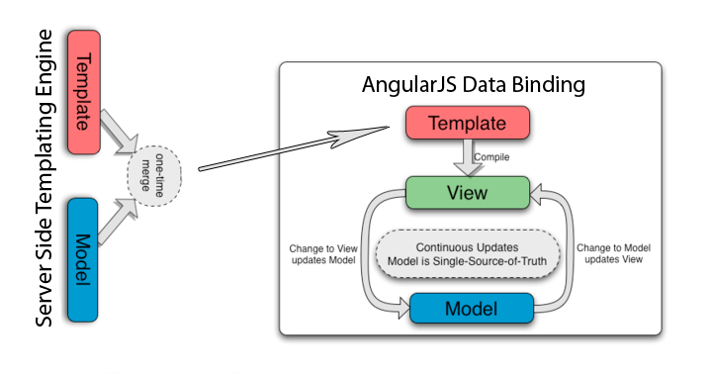
Architecture
Client - Server

Slide 10
Admin Module
Login
Dashboard
Students
Faculties
Librarian
Branches
Reports
Logout

Slide 11
Abhishek Yadav Admin Module, Events and Starter Project
Create a starter backend project using STS (Spring Tool Suite)
Configure the properties
Create a starter frontend project in angular using angulat cli
Create two github repos one for the backend and one for the frontend
Push both the stacks to created github repo
Add all my teammates as collaboarators in the github so that they able to push their respective modules
Created four branches in github so that there no code conflicts arises
admin-branch
faculty-branch
librarian-branch
Student-branch

Slide 12
Admin
Introduction
Admin Work is to manage all the college campus
Admin can take admission for students also have access to update and delete the students
Admin is the only one who can register faculty, librarian
Admin also able to update branches
Have access to all the Reports of fees, marksheets all the student's data
Another admin only created by existing admin
Also, events added by admin

Slide 13
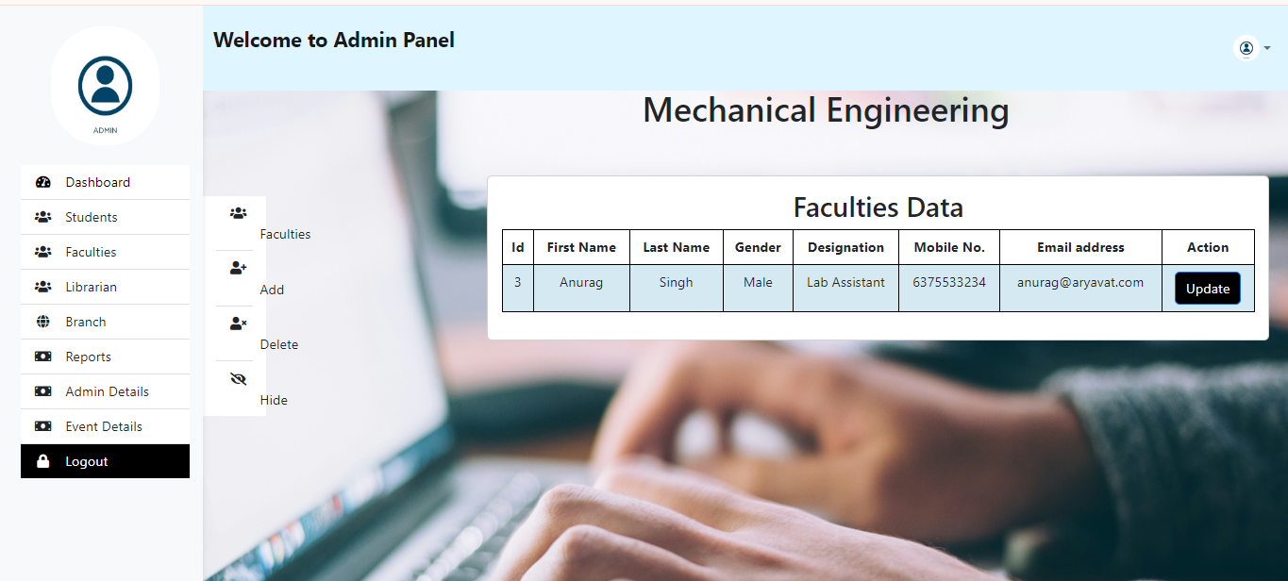
Faculty Lists

Slide 14
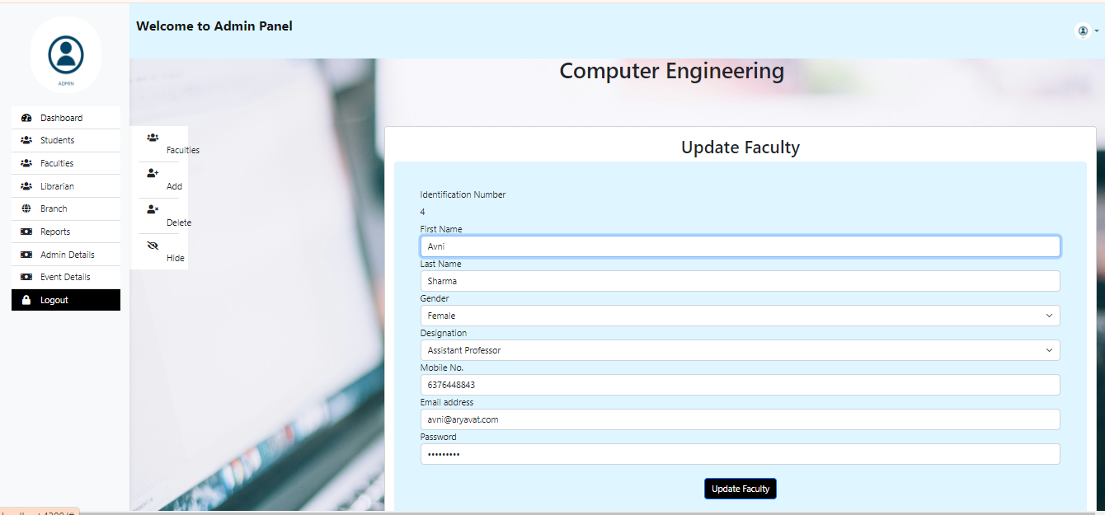
Faculty Update

Slide 15
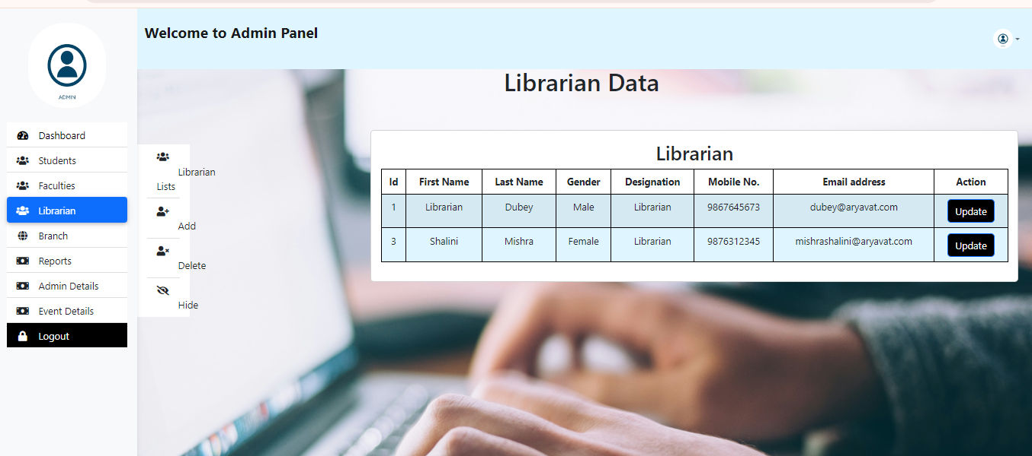
Librarian Lists

Slide 16
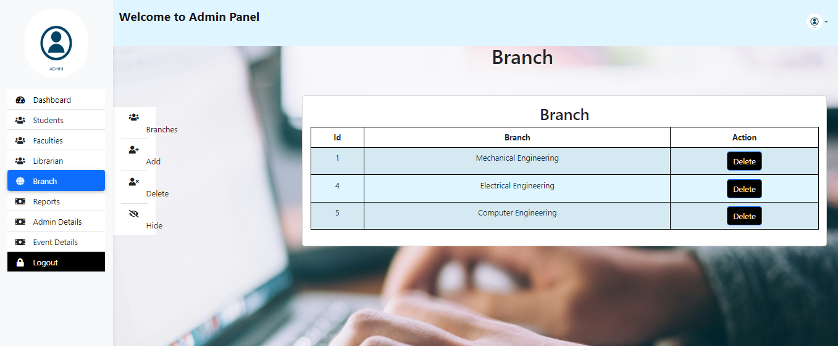
Branch Lists

Slide 17
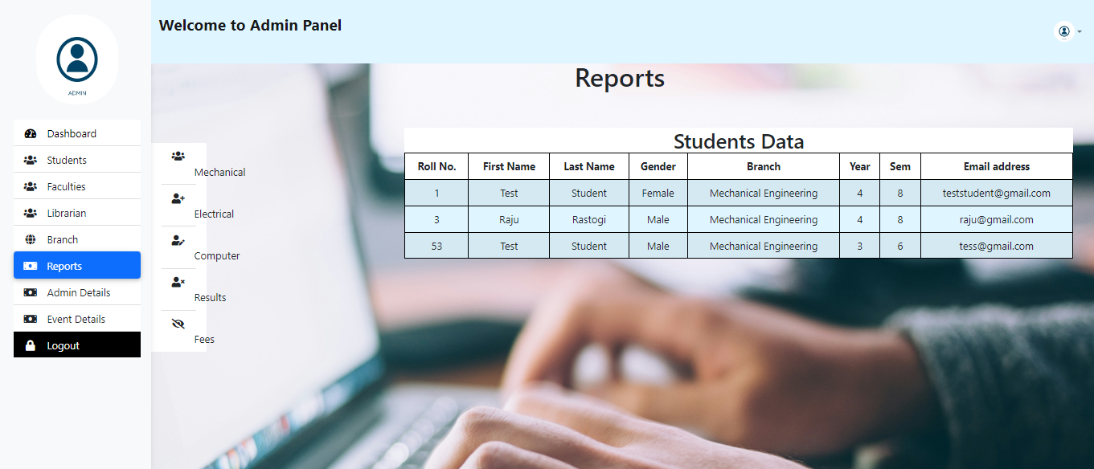
Reports

Slide 18
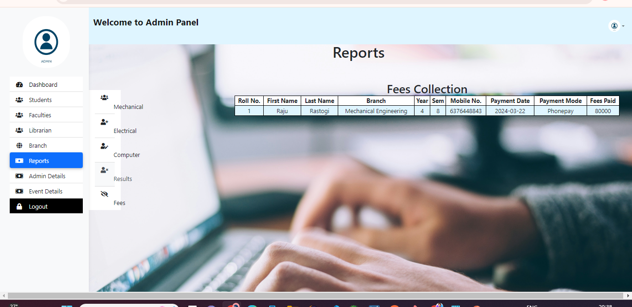
Fees

Slide 19
Events
Events in the fronted are also dynamic, admin can add update delete the events
There page for the past events
There also page for the top recruiters

Slide 20
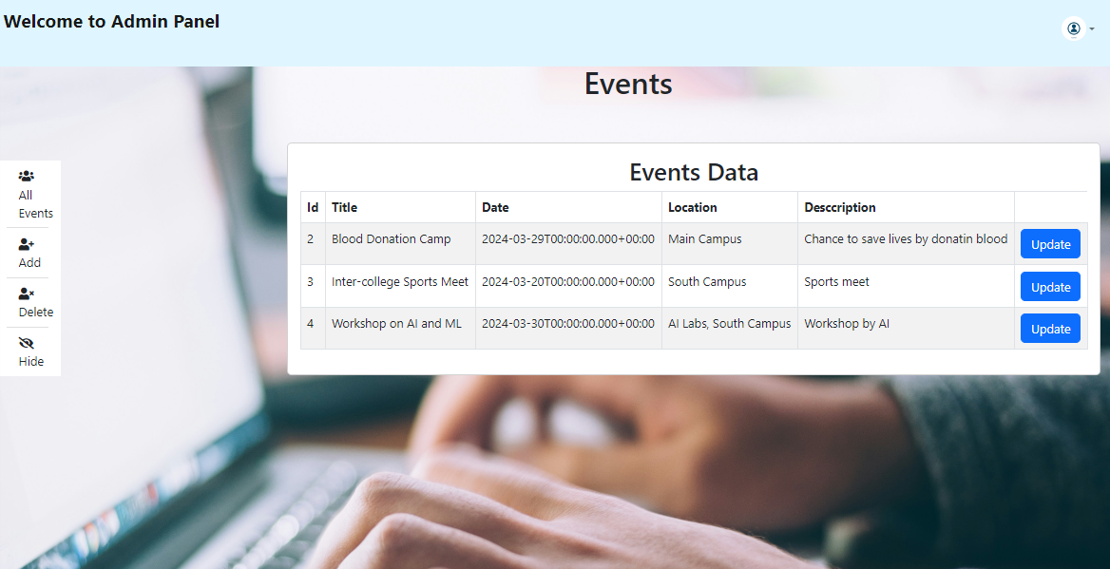
Events Details Admin page

Slide 21
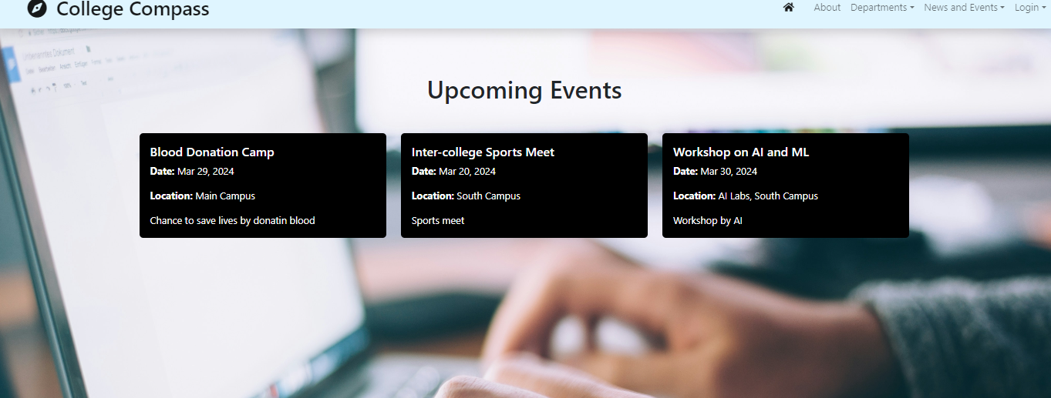
Public Events page

Slide 22
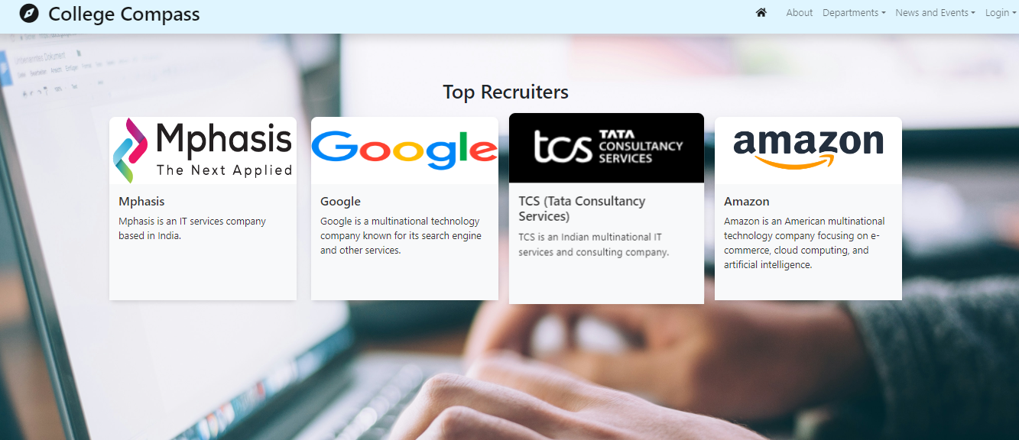
Top Recruiters

Slide 23
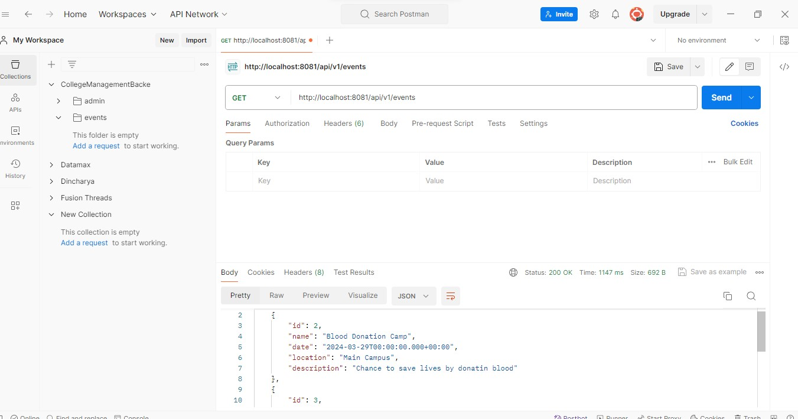
Api Testing Events end points

Slide 24
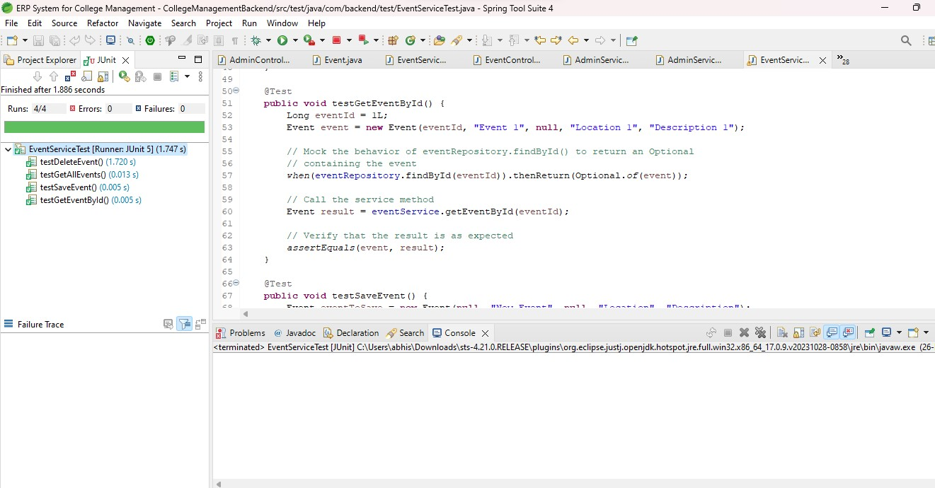
Events JUnit Testing

Slide 25
Admin Module/Student module
Admin login
Admin dashboard
Students
Admin details

Slide 26
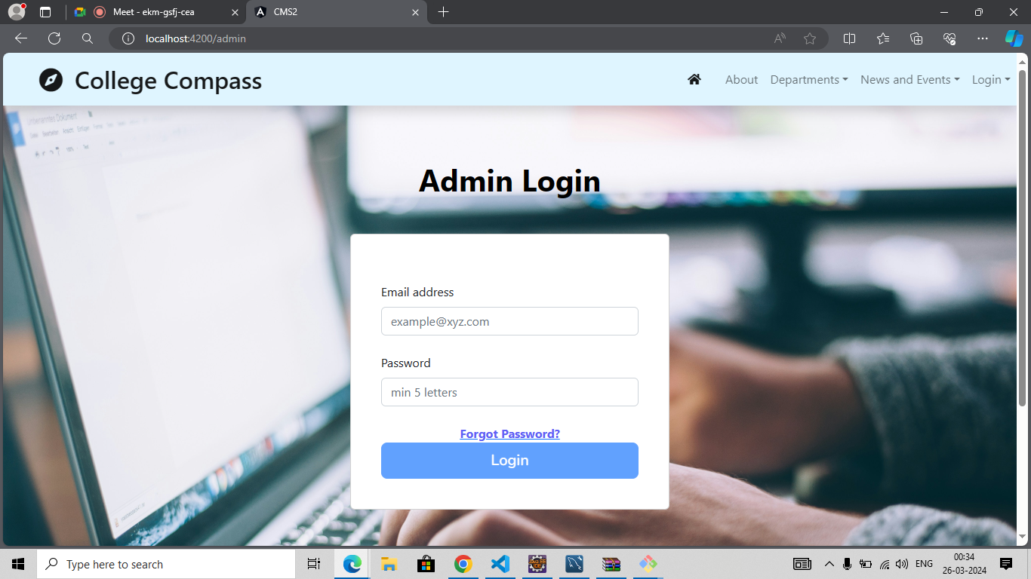
Admin login

Slide 27
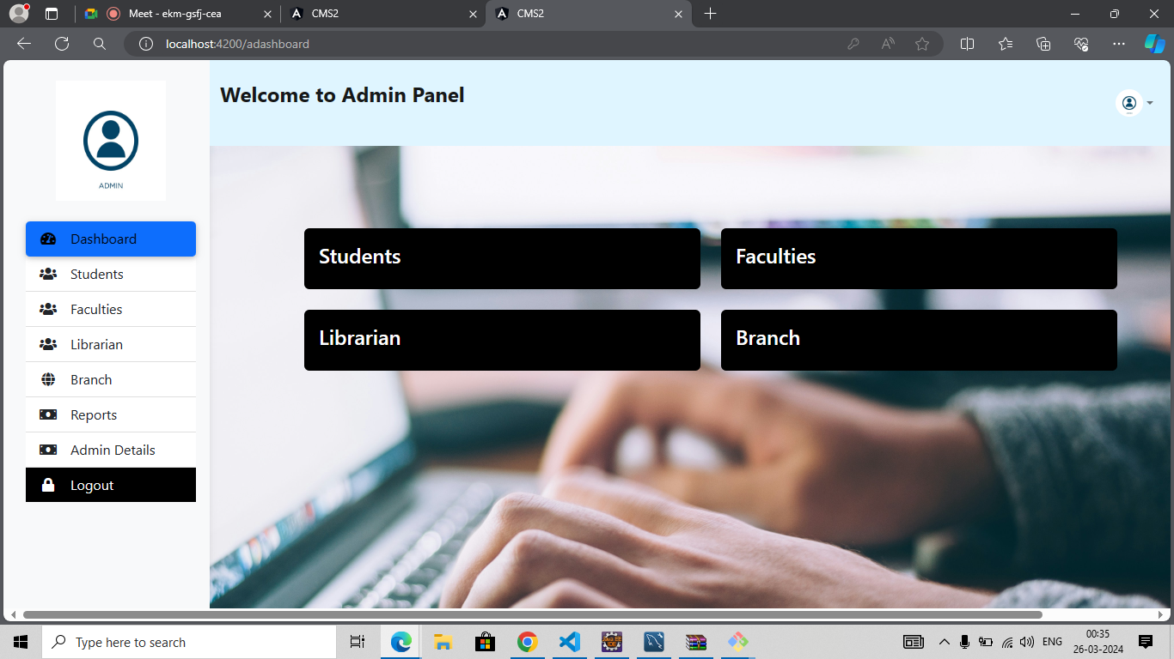
Admin Dashboard

Slide 28
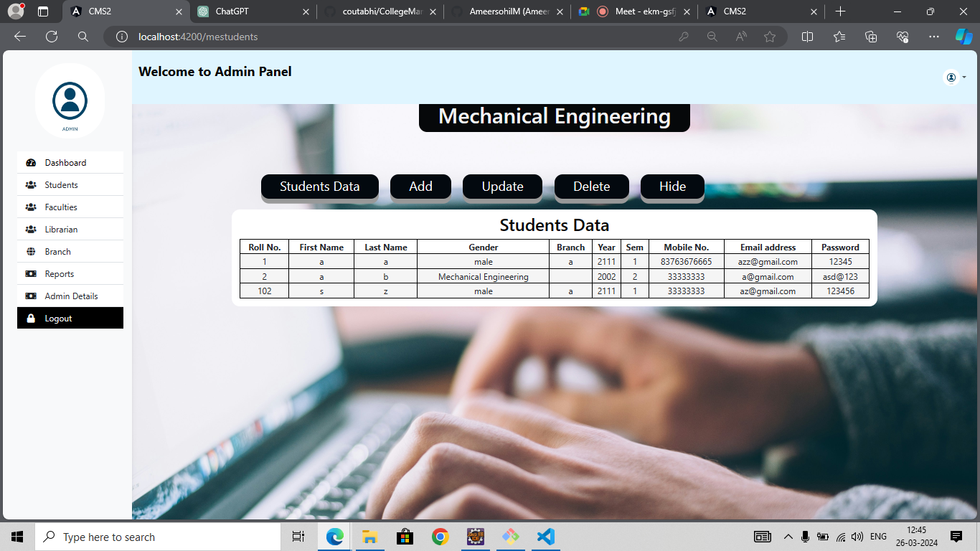
Students(ME)

Slide 29
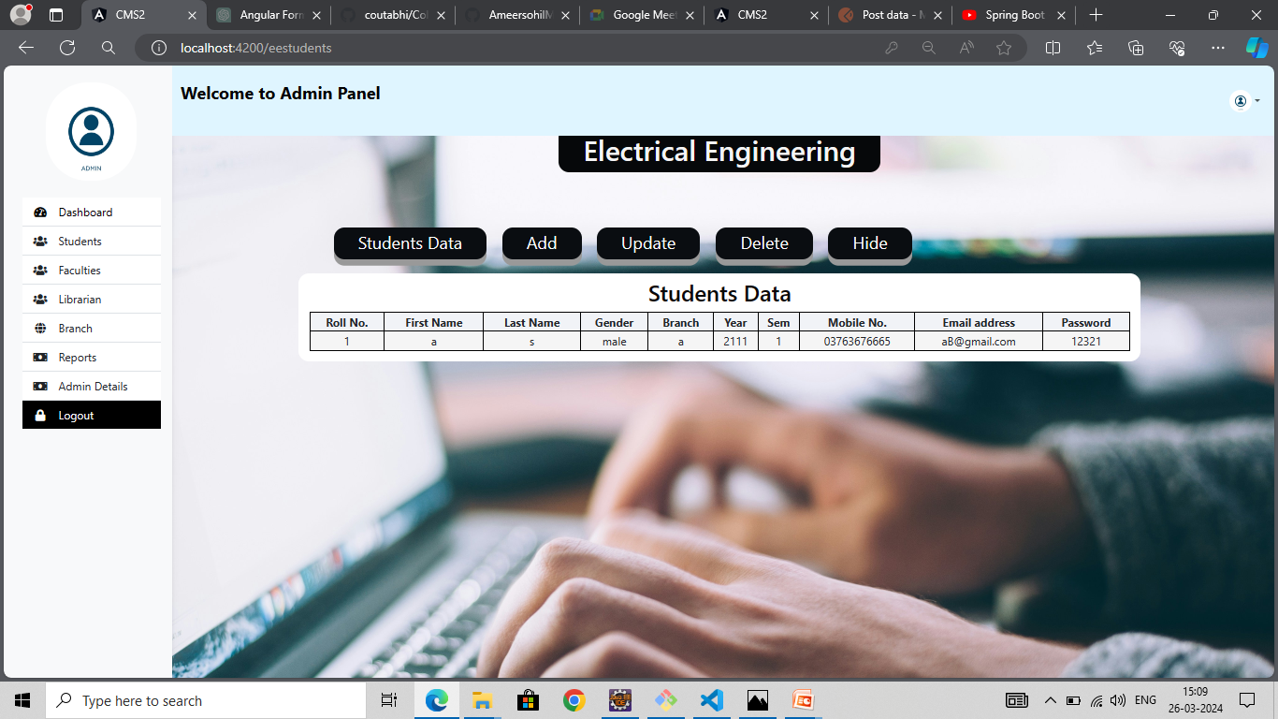
Student(EE)

Slide 30

Students(CE)

Slide 31
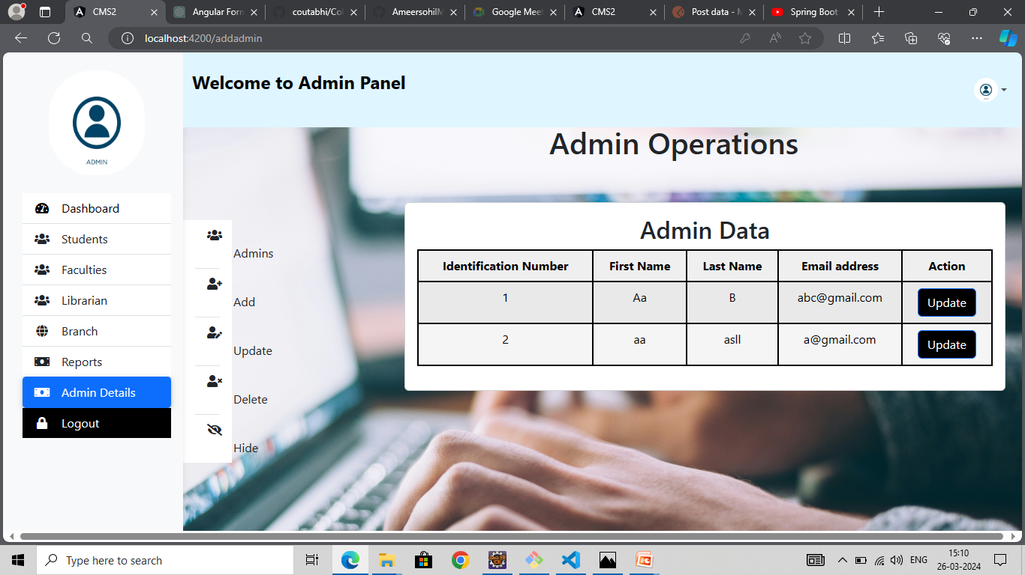
Admin details(Add)

Slide 32
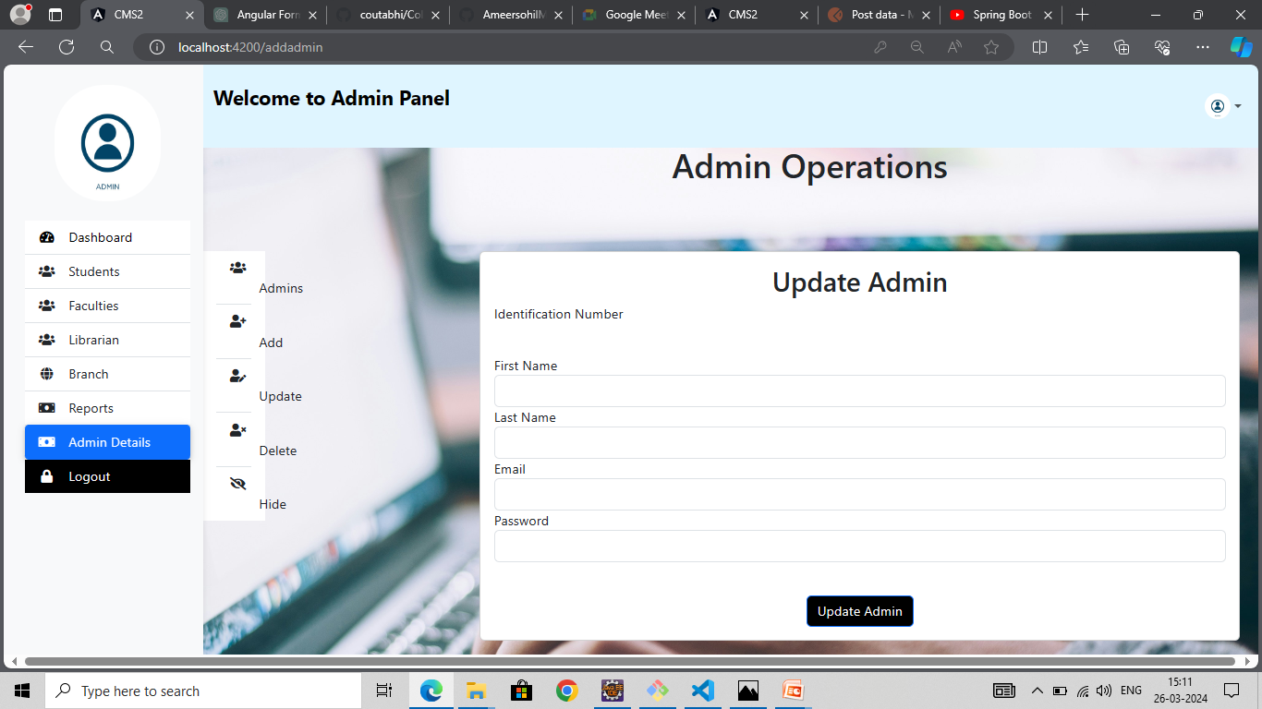
Students(Update)

Slide 33
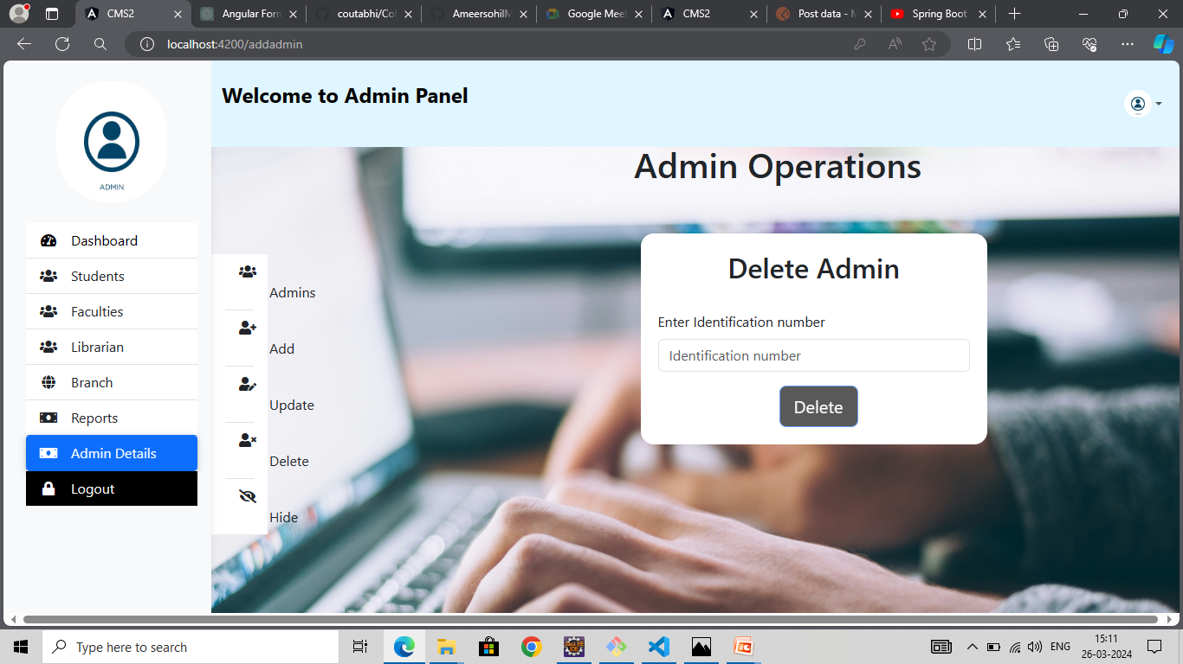
Admin details(delete)

Slide 34
Faculty module:
Faculty login
Dashboard
Students
Result

Slide 35
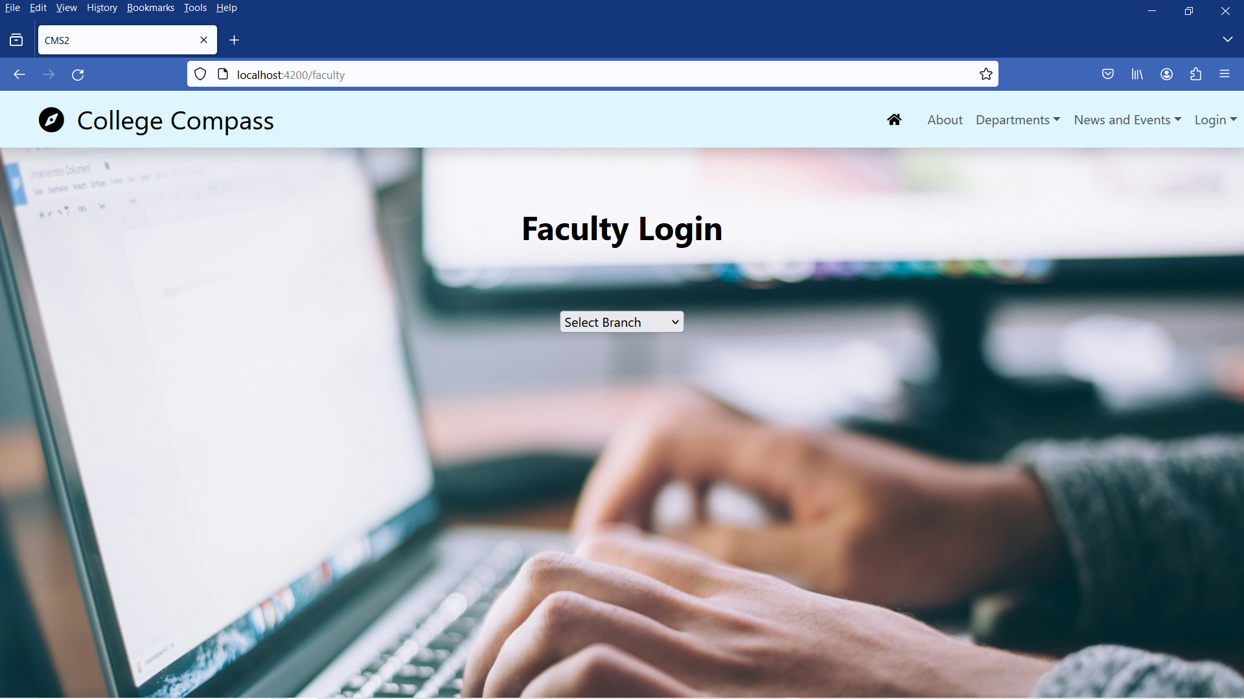
Faculty login:

Slide 36
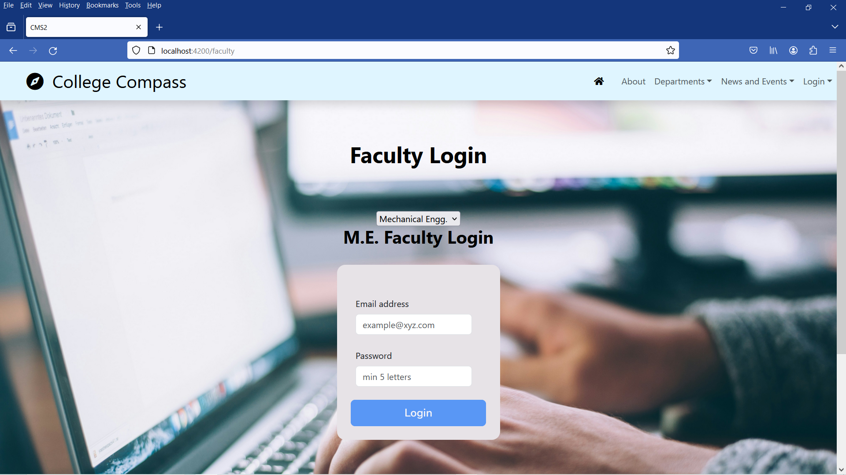
Select faculty login:

Slide 37
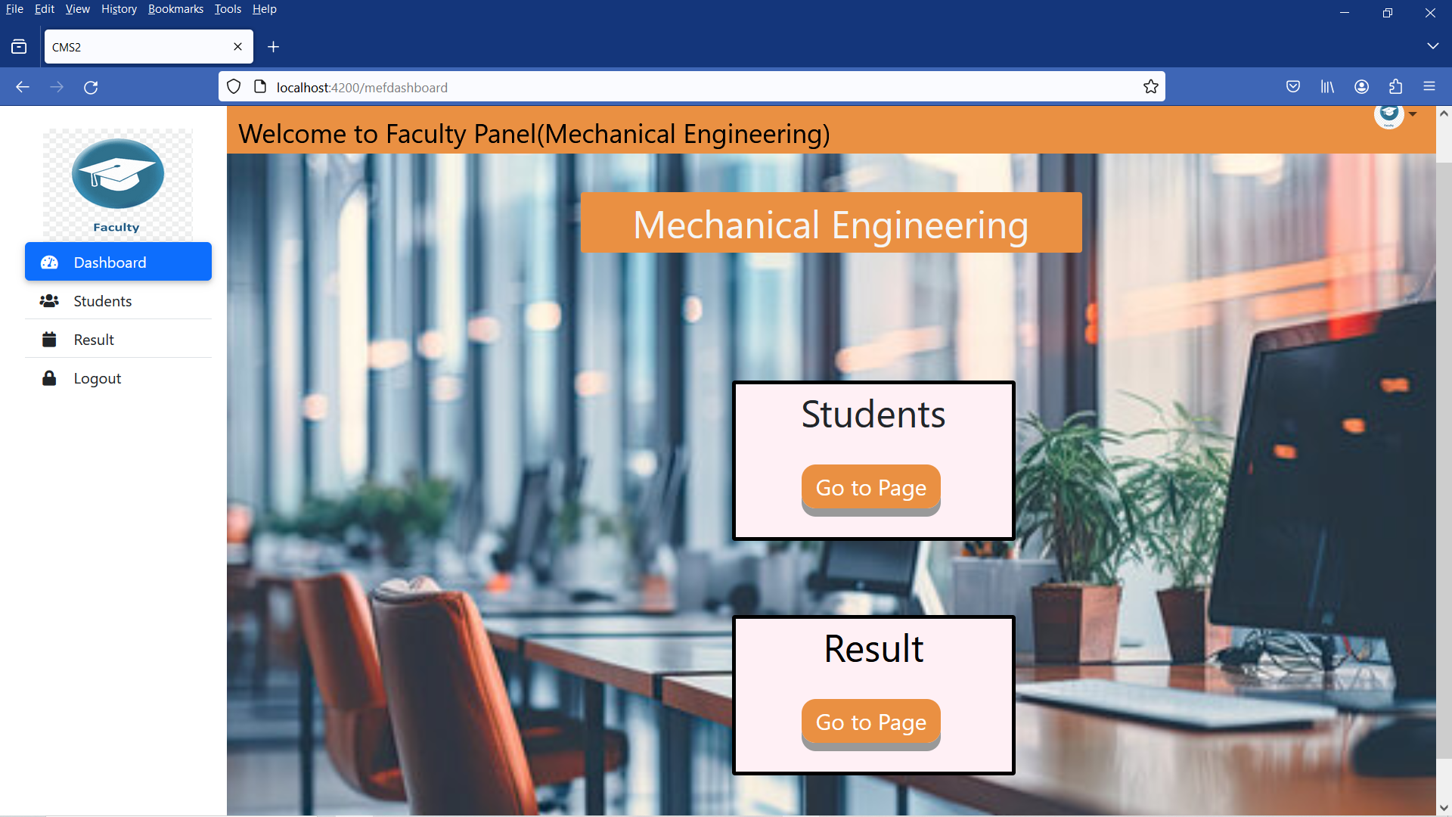
Dashboard:

Slide 38
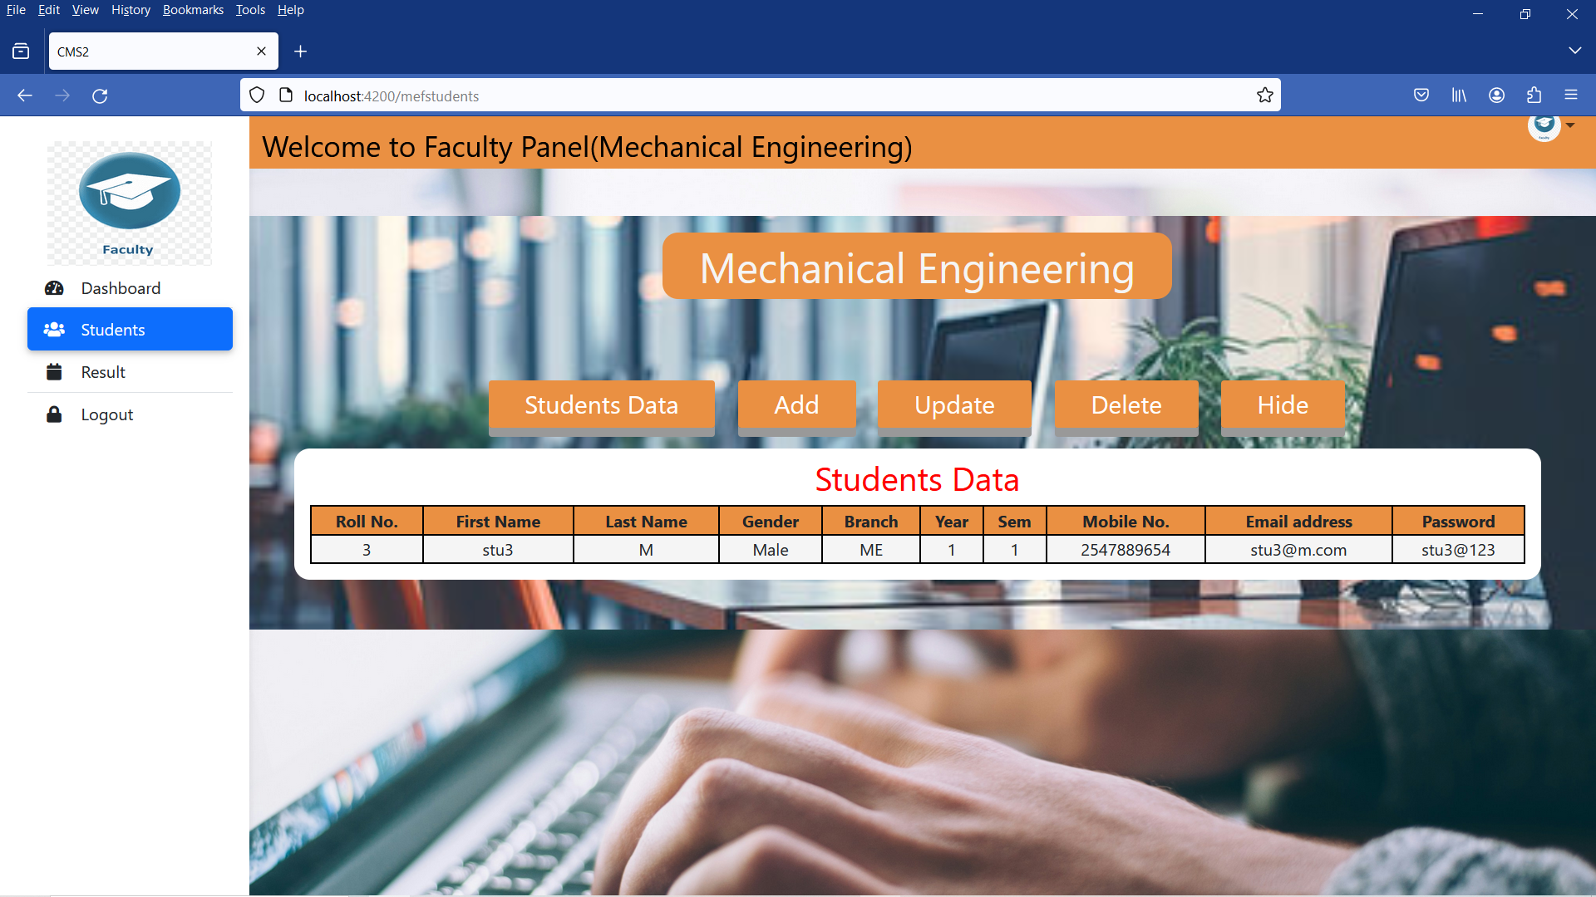
Students:

Slide 39
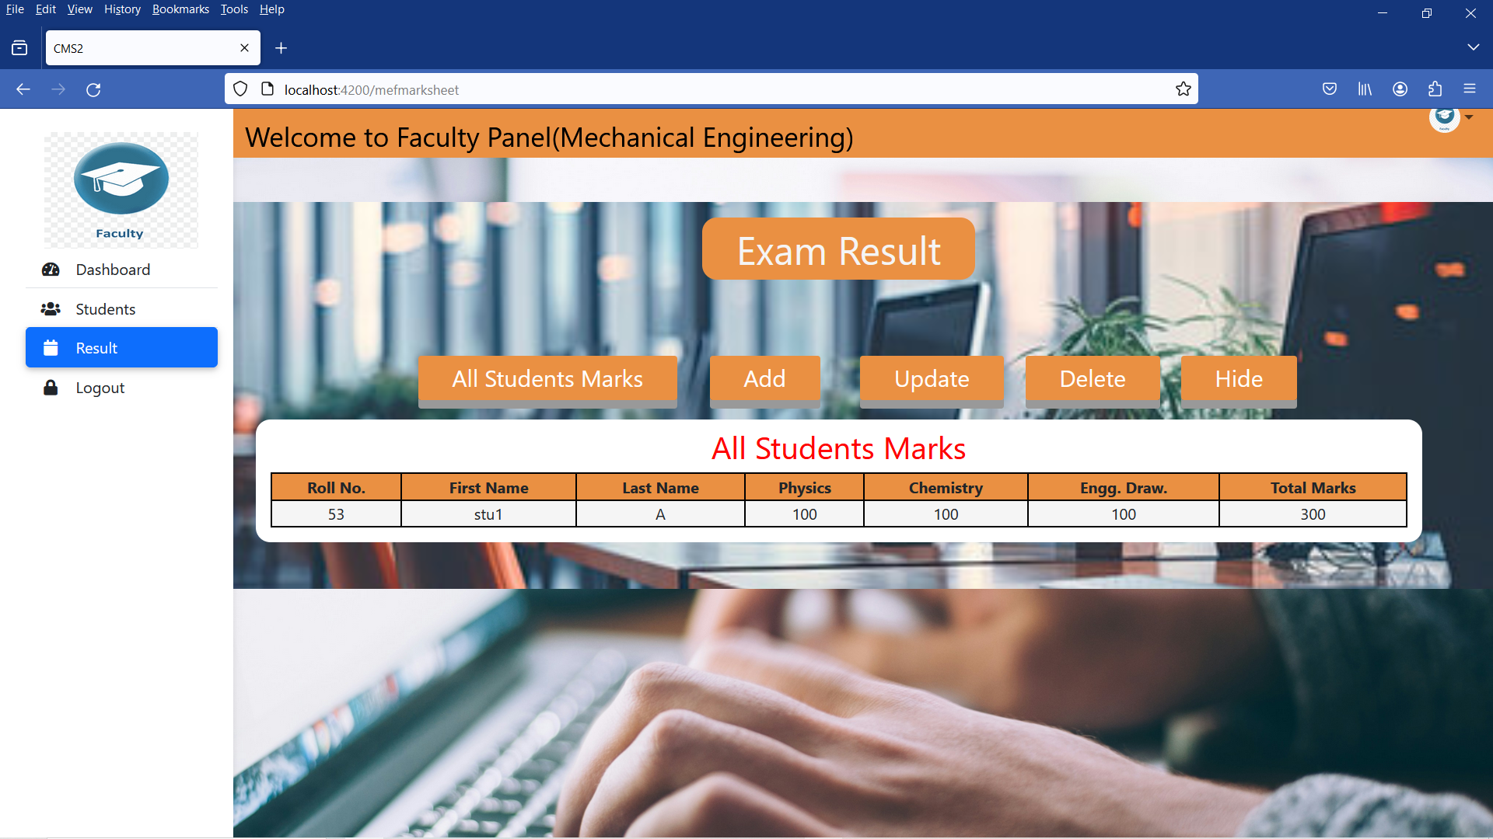
Result

Slide 40
Students Module: by Abhishek dhal and anuj
Sign Up
Login
Dashboard
Result
Fees

Slide 41
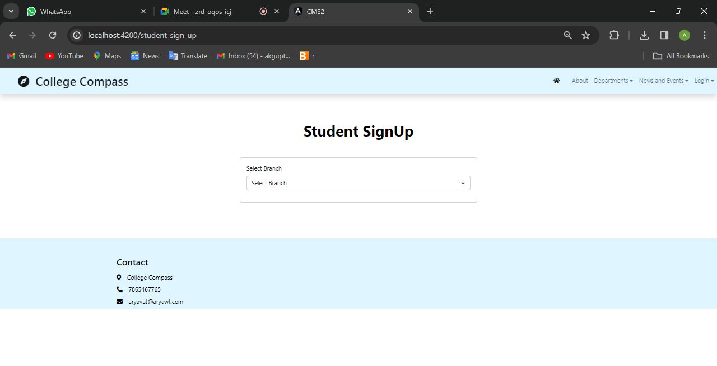
Student Panel (Sign Up):

Slide 42
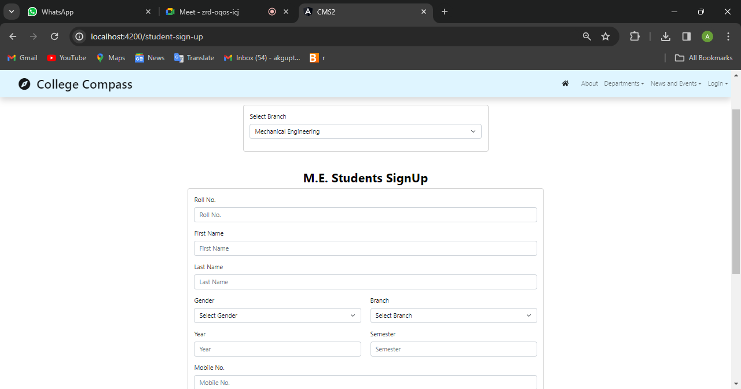
Student Panel (Sign Up):

Slide 43
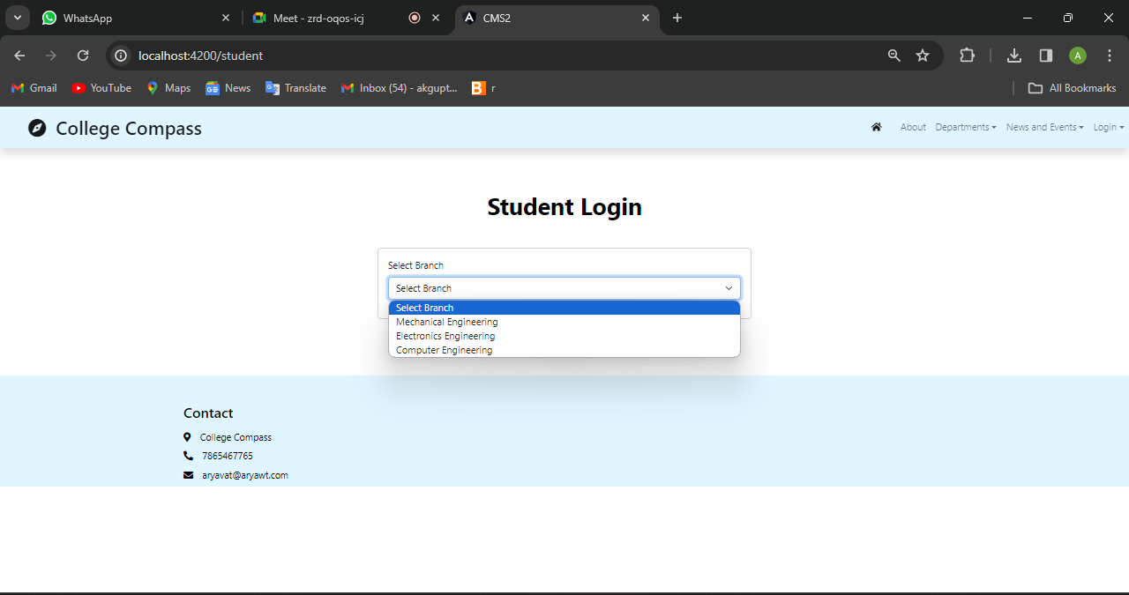
Student Panel (login):

Slide 44
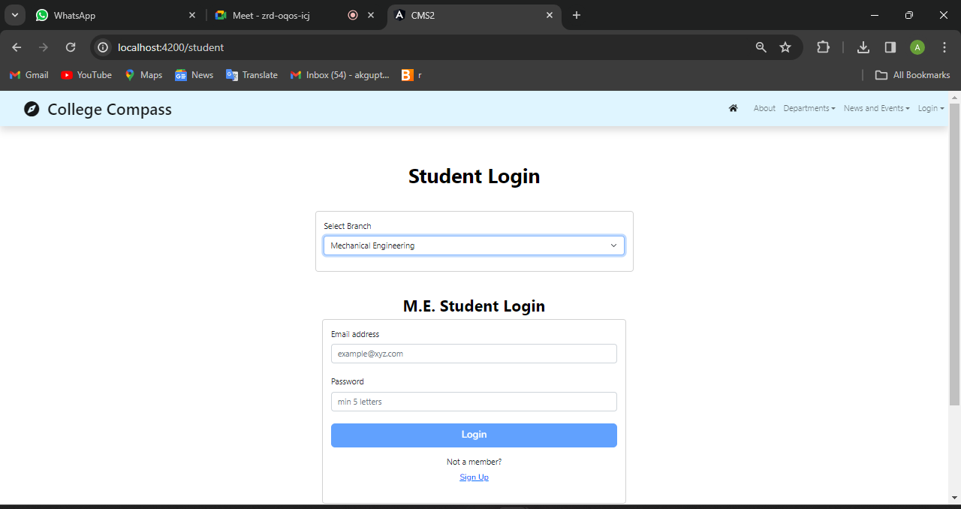
Student Panel (login):

Slide 45
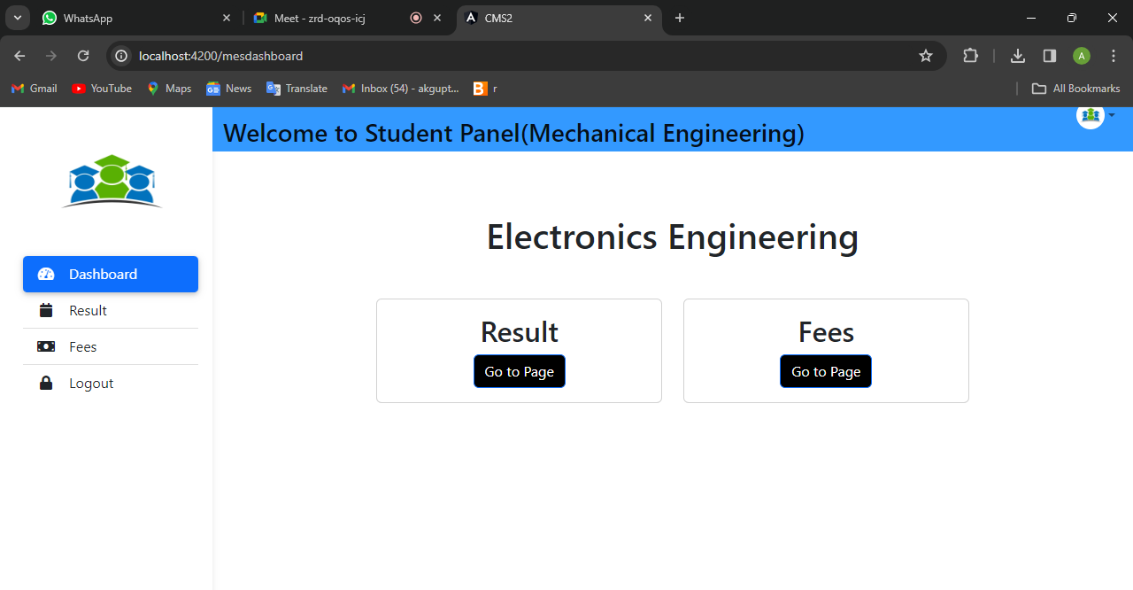
Student Panel(Dashboard):

Slide 46
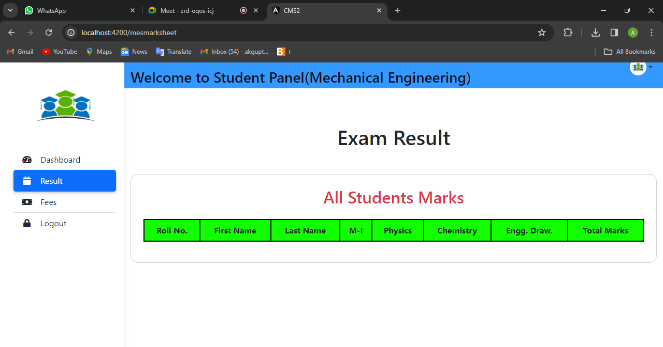
Student Panel(Result):

Slide 47
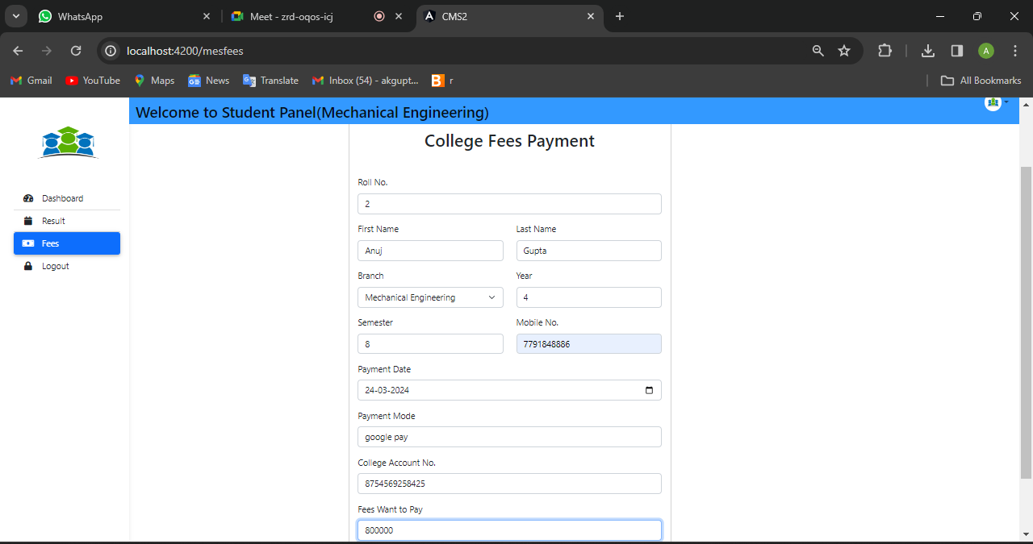
Student Panel(Fees):

Slide 48
LIBRARIAN MODULE
Front-End: Angular
Server-side: Spring Boot, Spring Data JPA
Back-end: MYSQL
Web Server: Tomcat

Slide 49
LIBRARIAN MODULE
Librarian login
Books
Add books
Delete books
Assigned books
Assign book
Delete assignment
Hide

Slide 50
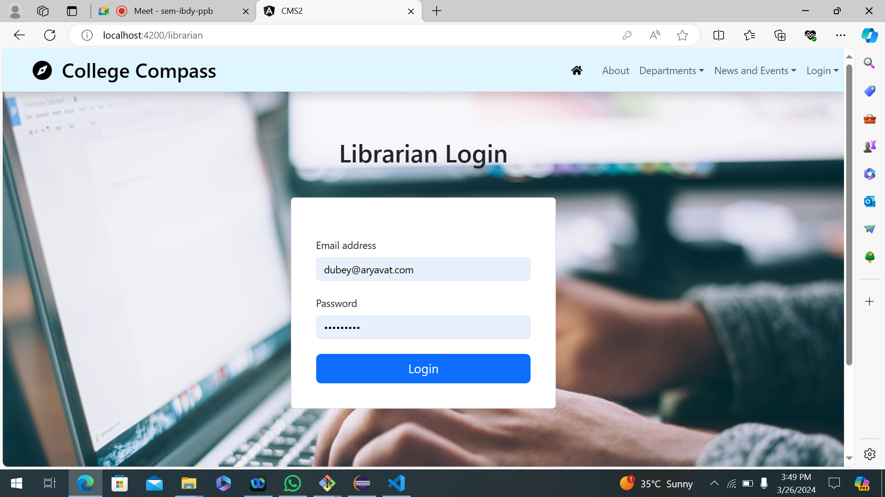
LIBRARIAN LOGIN

Slide 51
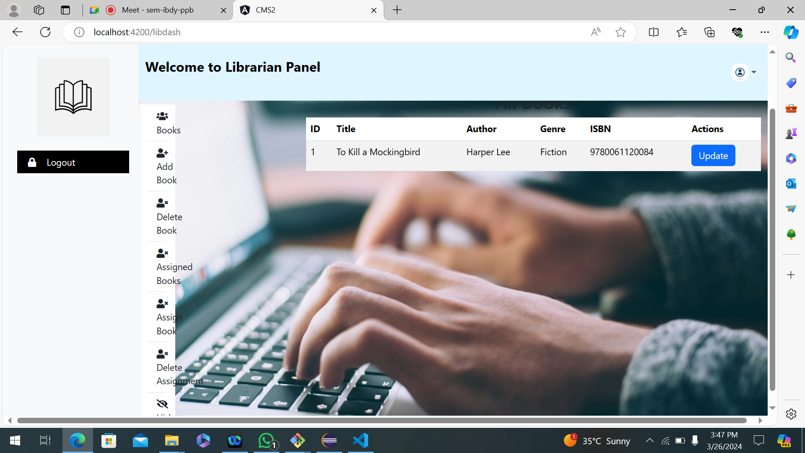
BOOKS

Slide 52
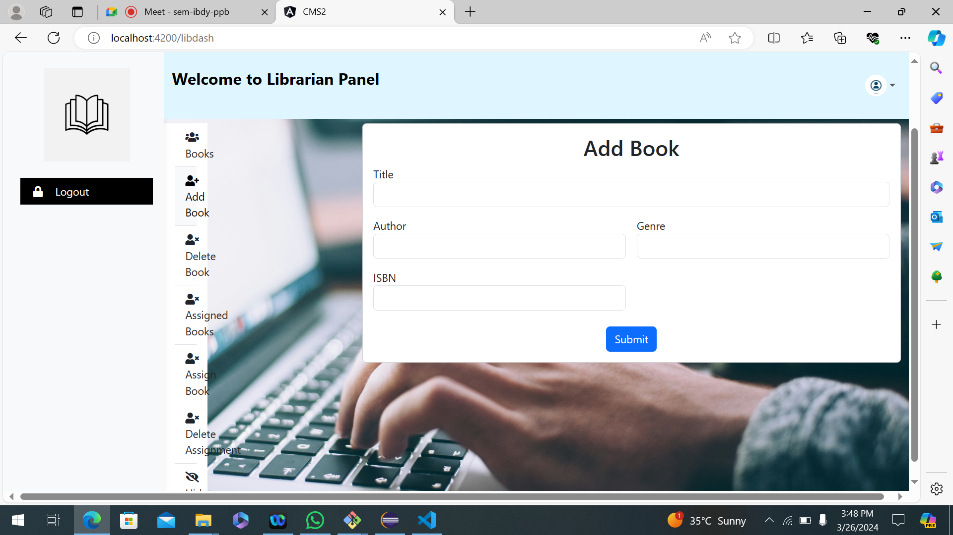
ADD BOOK

Slide 53
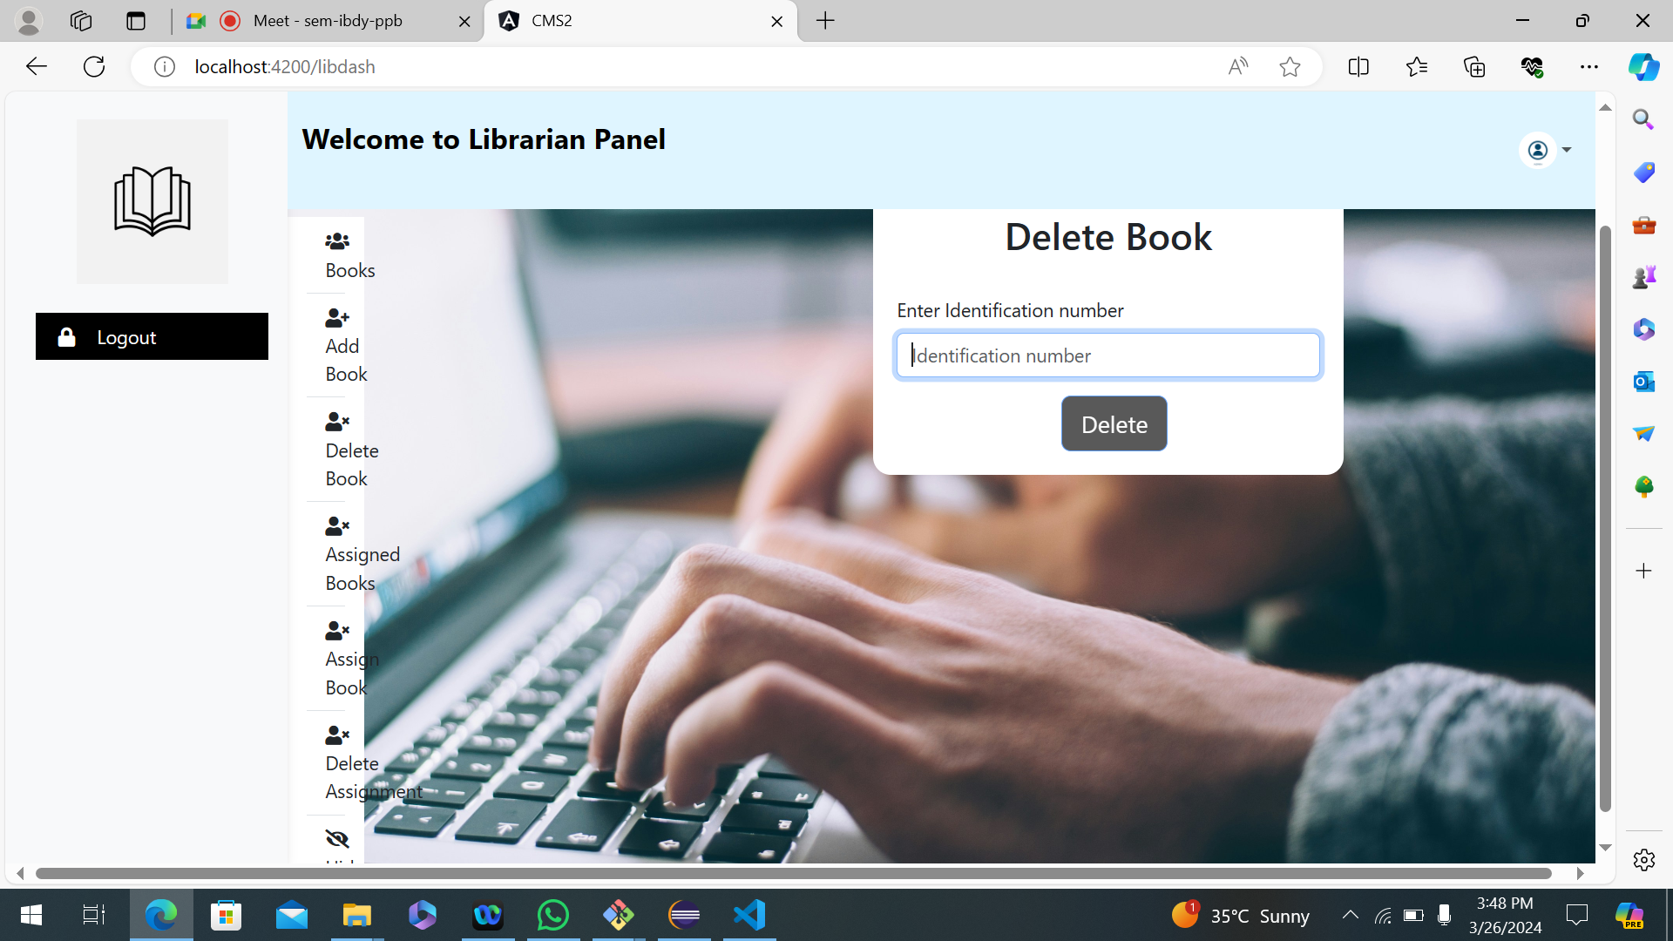
DELETE BOOK

Slide 54
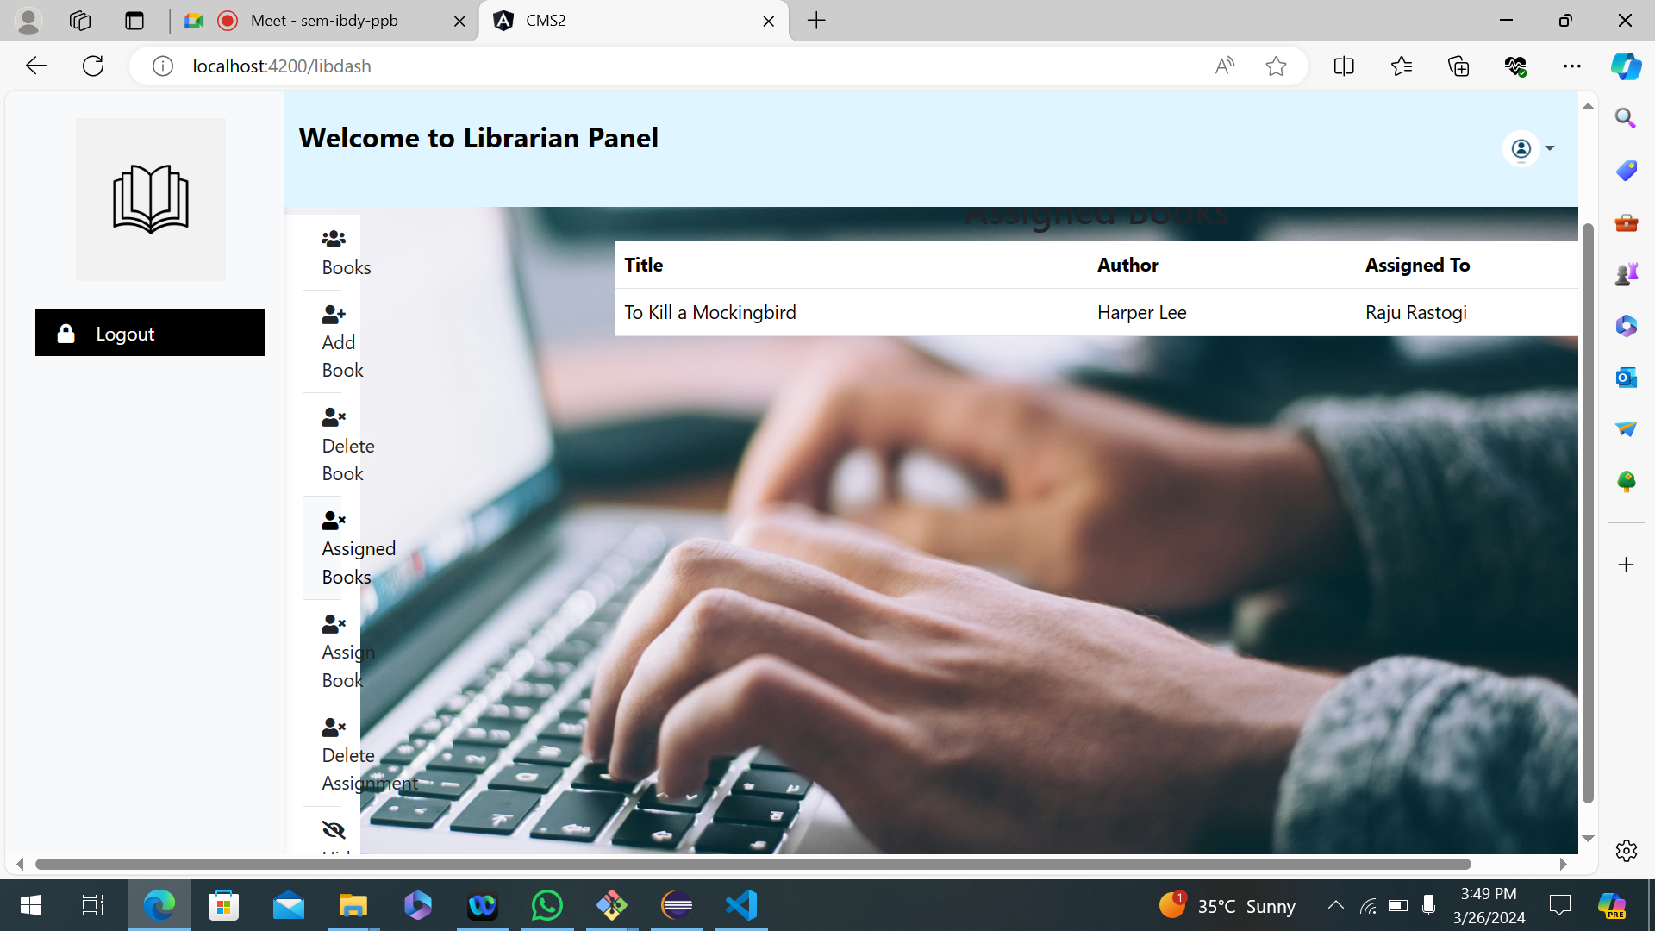
ASSIGNED BOOKS

Slide 55
ASSIGN BOOKS

Slide 56
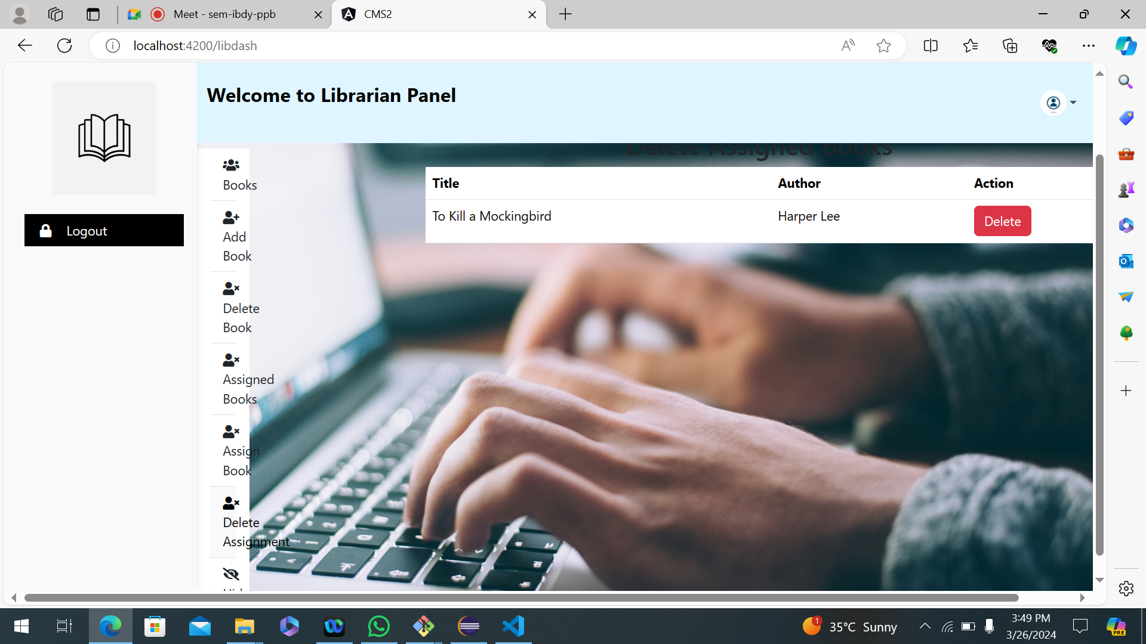
DELETE ASSIGNMENT

Slide 57
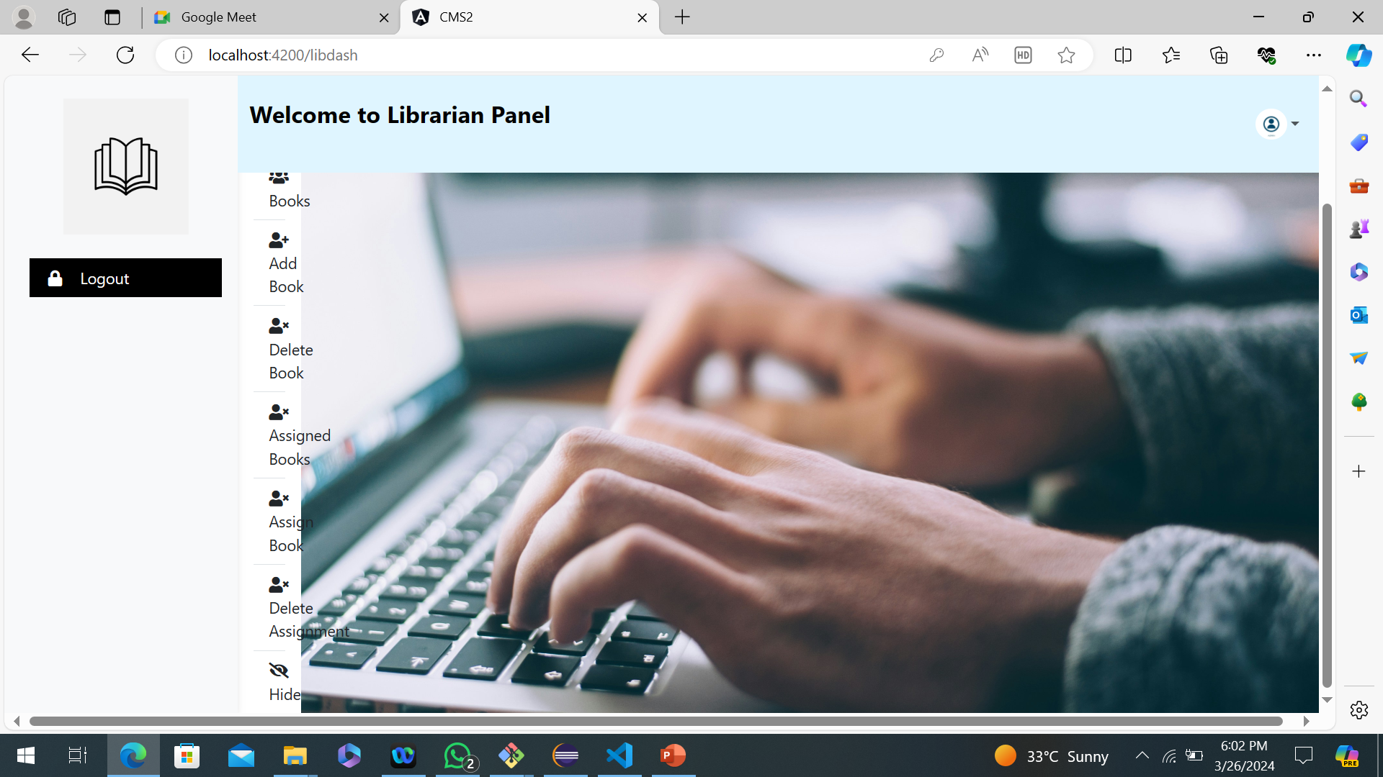
HIDE

Slide 58
Thanks Your suggestion and feedbacks will valuable for us

